Slide 1
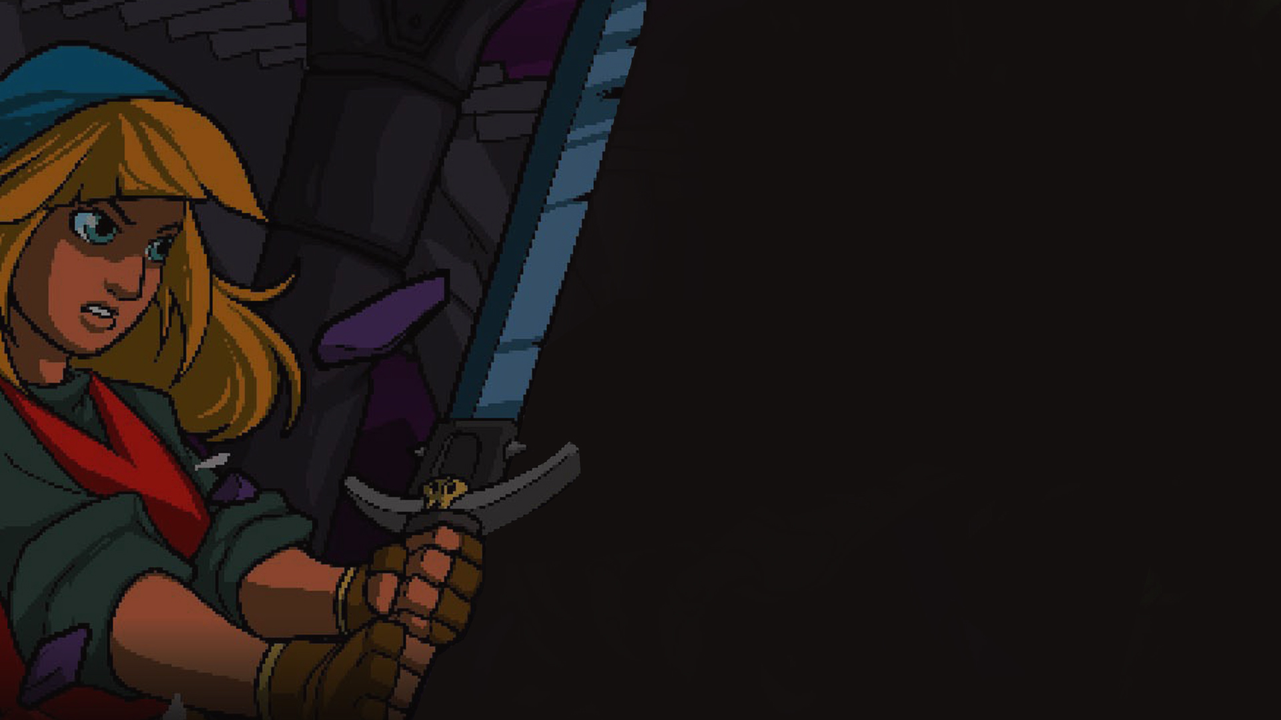

Sound Analysis
Alex Dru Ignacio Lars Robert

Slide 2

Game Basics

Slide 3

Game Basics
Rogue-like
dungeon crawler

Slide 4

Game Basics
Rogue-like
dungeon crawler
2D top-down
perspective

Slide 5

Game Basics
Rogue-like
dungeon crawler
2D top-down
perspective
One action
per beat

Slide 6
Game Basics
Rogue-like
dungeon crawler
2D top-down
perspective
One action
per beat

Slide 7
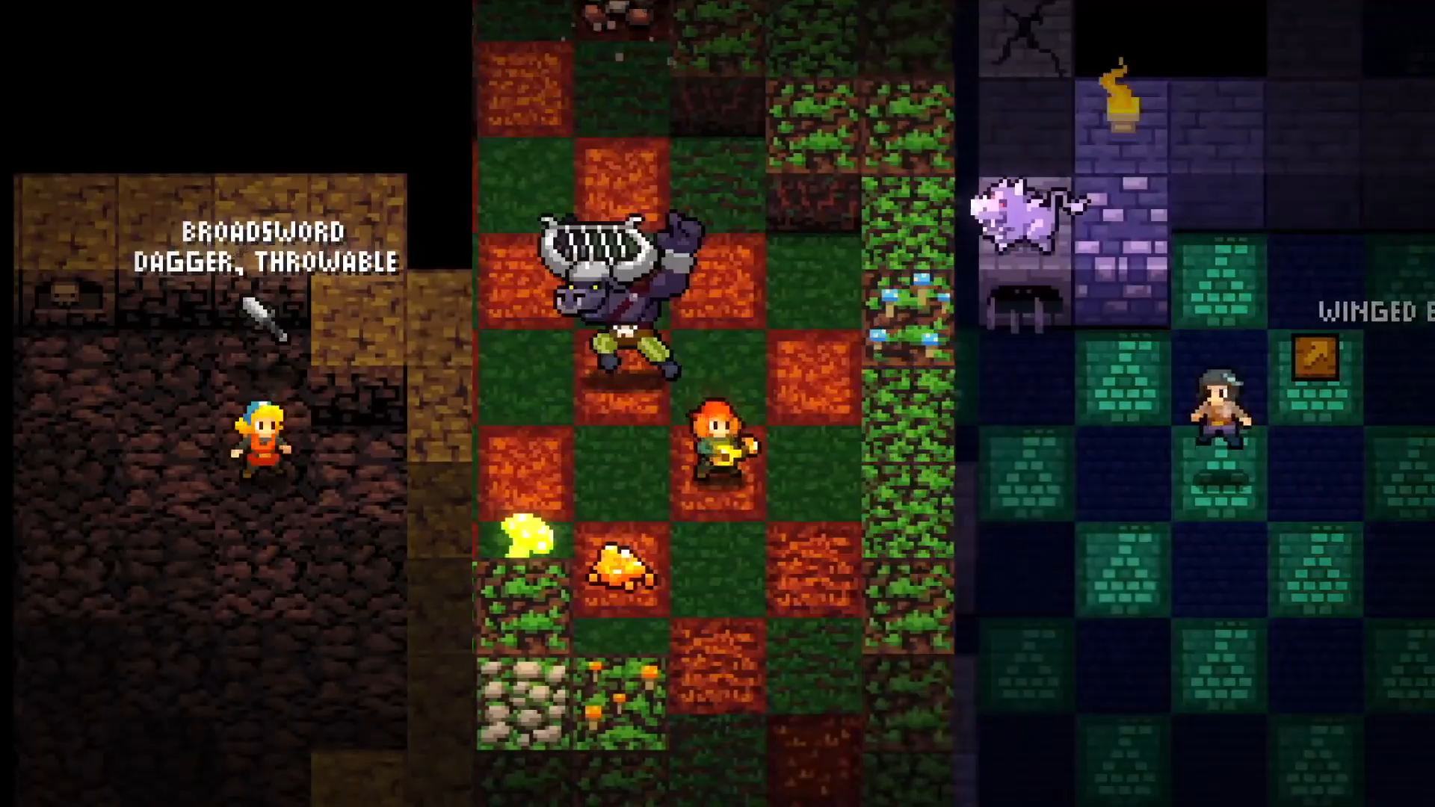
Trailer

Slide 8
Emotion

Slide 9

Emotion
No credibility
Sound does not match setting

Slide 10

Emotion
No credibility
Sound does not match setting
Gameplay immersion
Flow state

Slide 11

Emotion
No credibility
Sound does not match setting
Gameplay immersion
Flow state
Hyping and thrilling mood
Not atmospheric

Slide 12
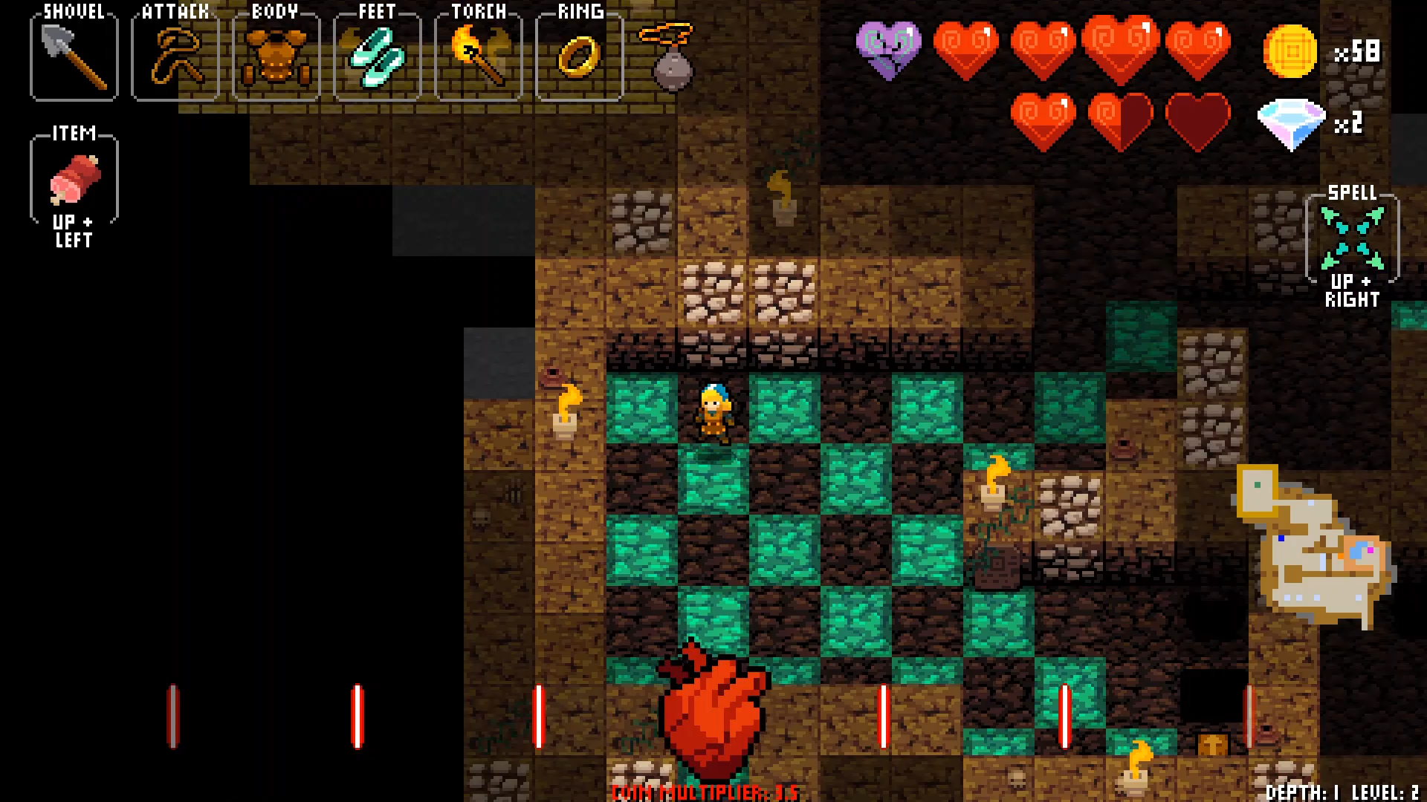
Level Transitions

Slide 13
Emotion
No credibility
Sound does not match setting
Gameplay immersion
Flow state
Hyping and thrilling mood
Not atmospheric

Slide 14

Emotion
No credibility
Sound does not match setting
Gameplay immersion
Flow state
Hyping and thrilling mood
Not atmospheric
Sense of presence through beat
Connects everything in game world

Slide 15
Emotion
No credibility
Sound does not match setting
Gameplay immersion
Flow state
Hyping and thrilling mood
Not atmospheric
Sense of presence through beat
Connects everything in game world

Slide 16
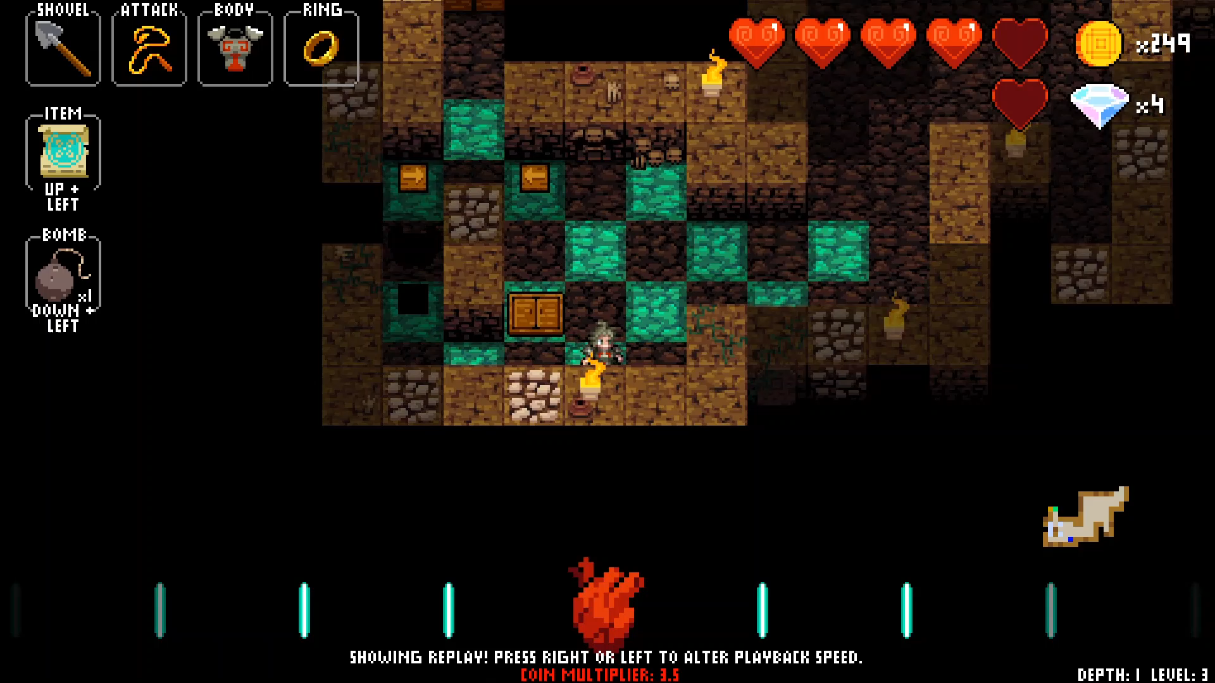
Singing Shopkeeper

Slide 17
Information

Slide 18

Information
Feedback effects for all key actions
Sounds are shorter than a beat
Beat for movement

Slide 19

Information
Feedback effects for all key actions
Sounds are shorter than a beat
Beat for movement
Tutorial with voice-over instructions
Beat tells player when to move
Antechambers to learn boss tracks

Slide 20
Information
Feedback effects for all key actions
Sounds are shorter than a beat
Beat for movement
Tutorial with voice-over instructions
Beat tells player when to move
Antechambers to learn boss tracks

Slide 21
Gameplay

Slide 22

Gameplay
Sound enables navigation
Singing helps find shop

Slide 23

Gameplay
Sound enables navigation
Singing helps find shop
New track every level
Custom track option

Slide 24

Gameplay
Sound enables navigation
Singing helps find shop
Increasing tempo for difficulty
Special rhythms for boss tracks
New track every level
Custom track option

Slide 25
Gameplay
Sound enables navigation
Singing helps find shop
Increasing tempo for difficulty
Special rhythms for boss tracks
New track every level
Custom track option

Slide 26
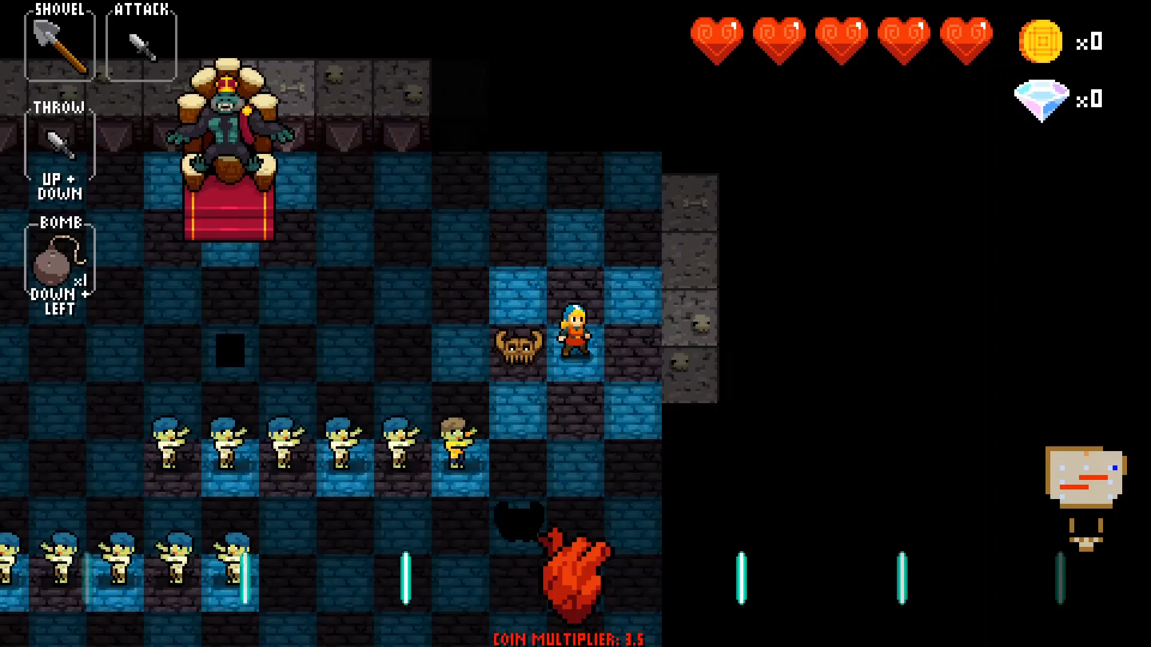
Boss Track (King Conga)

Slide 27
Audio Gameplay

Slide 28

Audio Gameplay
Turn-based structure made real-time
Beat determines start and end of turn

Slide 29

Audio Gameplay
Turn-based structure made real-time
Beat determines start and end of turn
Tracks do not loop
If song ends, next level begins

Slide 30
Audio Gameplay
Turn-based structure made real-time
Beat determines start and end of turn
Tracks do not loop
If song ends, next level begins

Slide 31
Sound & Visuals

Slide 32
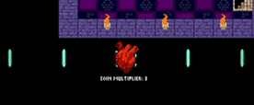
Sound & Visuals
Heartbeat as visual aid

Slide 33
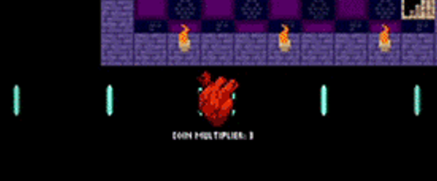
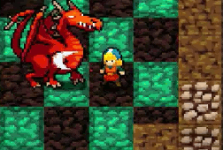
Sound & Visuals
Heartbeat as visual aid
Floor tiles change color

Slide 34
Sound & Visuals
Heartbeat as visual aid
Floor tiles change color

Slide 35
Personal Opinion

Slide 36
Personal Opinion
Unique concept

Slide 37

Personal Opinion
Unique concept
Consistent execution

Slide 38

Personal Opinion
Unique concept
Feeling of mastery
Consistent execution

Slide 39
Personal Opinion
Unique concept
Feeling of mastery
Consistent execution
Flow state emerges

Slide 40

Personal Opinion
Unique concept
Feeling of mastery
Artificial game time feels organic
Consistent execution
Flow state emerges

Slide 41
Personal Opinion
Unique concept
Feeling of mastery
Artificial game time feels organic
Consistent execution
Flow state emerges

Slide 42
Personal Opinion

Slide 43

Personal Opinion
Sound clashes with setting

Slide 44

Personal Opinion
Sound clashes with setting
Too repetitive

Slide 45

Personal Opinion
Sound clashes with setting
Easy to get out of flow state
Too repetitive

Slide 46
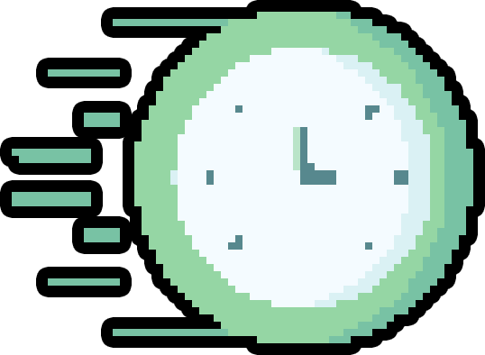
Personal Opinion
Sound clashes with setting
Easy to get out of flow state
Too repetitive
No time to think

Slide 47
Personal Opinion
Sound clashes with setting
Easy to get out of flow state
Too repetitive
No time to think

Slide 48
Thank you for your attention!
Any questions?
Alex Dru Ignacio Lars Robert

